Slide 1
Data Structures and Algorithms -3 (25CS2103E)
Automated Project Task Planning and Scheduling
Team Members:
Md Aman - 2520030190
V. Sree Pragnya - 2520030238
Vaishnavi - 2520030247
Under the Esteemed Guidance of
Yamini Devi
Assistant Professor

Slide 2
Contents
Abstract
Introduction
Literature survey
Problem Statement and Objectives
Hardware and Software requirements
Results
Conclusion
Future Scope

Slide 3
Abstract
Develops a Project Scheduling System to manage tasks and their dependencies.
Represents tasks and dependencies using a Directed Graph (DAG).
Uses Topological Sorting to generate a valid task execution order.
Calculates task completion times while satisfying precedence constraints.
Identifies the Critical Path and critical tasks affecting project completion.
Helps determine the minimum overall project completion time.
Demonstrates the application of graph algorithms and optimization techniques in real-world project management.
Designed to efficiently handle up to 1000 tasks.

Slide 4
Introduction
Project management involves handling multiple tasks that may have dependencies and execution constraints.
A task can begin only after its required predecessor tasks are completed.
Managing these dependencies manually becomes difficult as the number of tasks increases.
The proposed system represents tasks and dependencies using a Directed Graph.
Topological Sorting is used to determine a valid execution sequence that satisfies all dependencies.
Task durations are considered to calculate the project completion time and critical path.
The system demonstrates the use of graph algorithms and optimization techniques for real-world scheduling problems.
It supports efficient scheduling for projects containing up to 1000 tasks.

Slide 5
Literature Survey
Graph-Based Scheduling: Project tasks can be represented as vertices and dependencies as directed edges. Topological sorting helps generate a valid task execution sequence.
Critical Path & Optimization: Scheduling approaches analyze task durations and dependencies to identify critical tasks and reduce overall project completion time.
Advanced Scheduling: The DSA-3 course recognizes scheduling as an optimization problem and includes computational complexity and approximation techniques for scheduling.

Slide 6
Problem Statement and Objectives
Problem Statement:
Project tasks often have dependencies and precedence constraints that determine their execution order.
Manually managing these dependencies becomes difficult as the number of tasks increases.
The system aims to generate a valid and optimized execution schedule while satisfying all task dependencies.
It also identifies critical tasks and the overall project completion time.
Objectives:
Add and manage project tasks, durations, and dependencies.
Use Graph and Topological Sorting to determine the correct execution order.
Detect circular dependencies that make scheduling impossible.
Calculate the minimum project completion time.
Identify the Critical Path and critical tasks.
Efficiently handle projects with up to 1000 tasks.

Slide 7
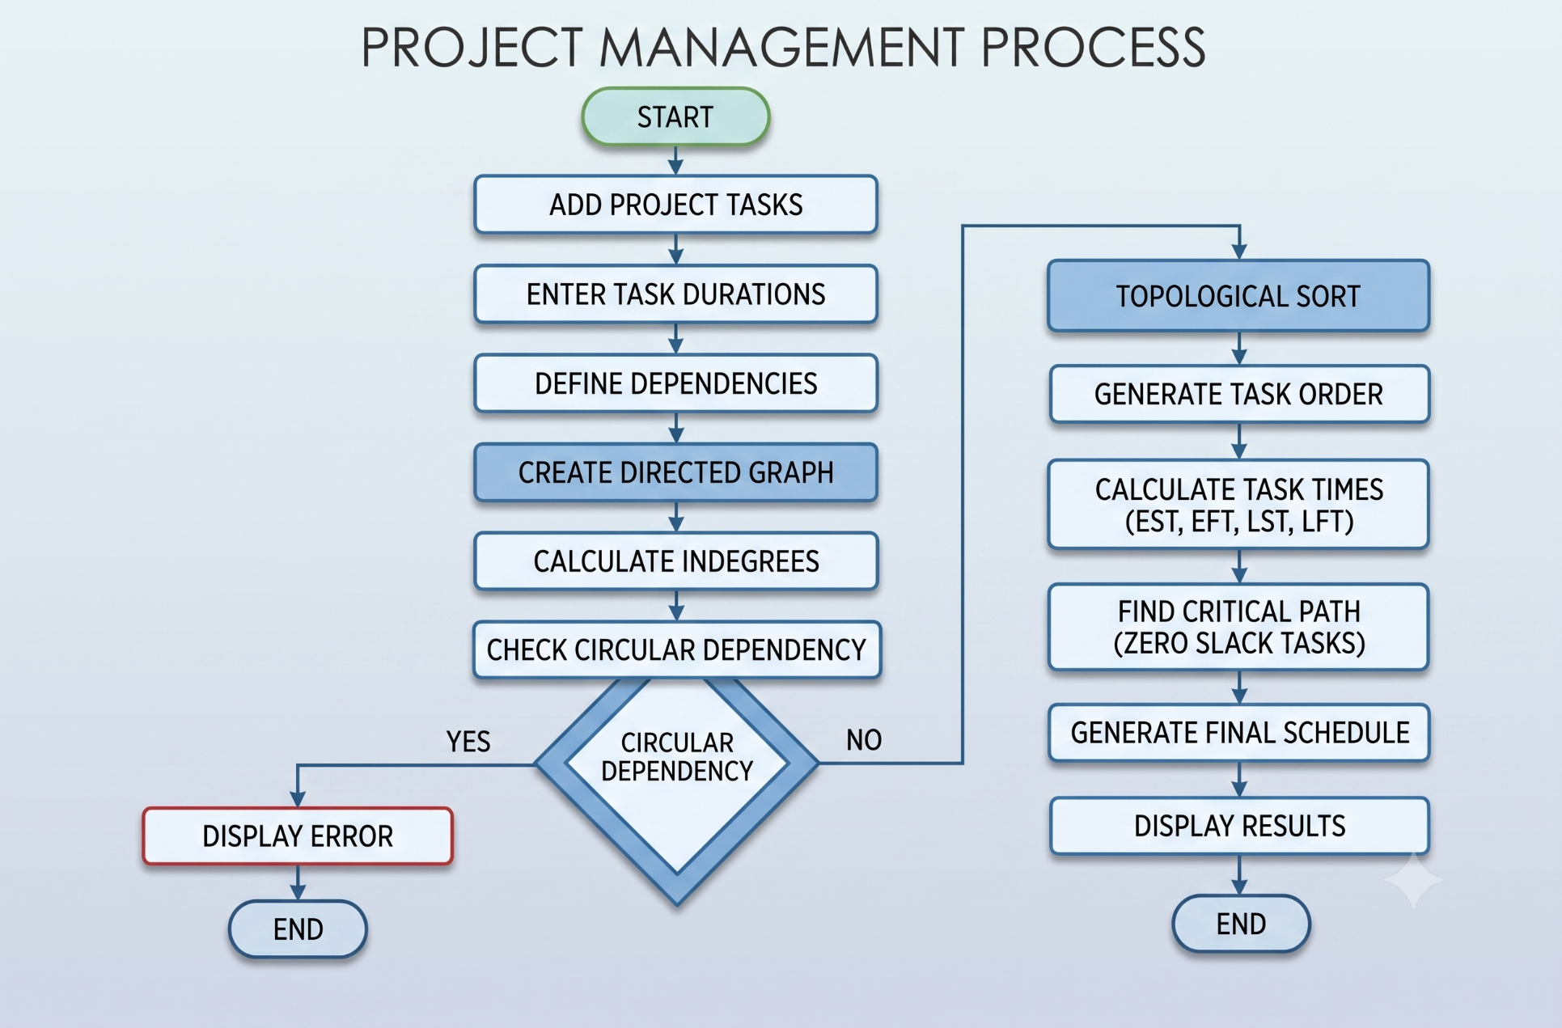
  Flow Chart

Slide 8
Results
Successfully generated a valid project execution schedule while satisfying all task dependencies.
Topological Sorting determined the correct order of task execution and helped identify circular dependencies.
Task durations were analyzed to calculate the minimum project completion time.
The Critical Path and critical tasks were identified for effective project management.
The system demonstrates the application of graph algorithms and optimization techniques to project scheduling.

Slide 9
Hardware and Software requirements
Hardware Requirements:
Processor: Intel Core i3 or equivalent
RAM: Minimum 4 GB
Storage: Minimum 10 GB free space
Display: Standard monitor
Keyboard & Mouse
Software Requirements:
Operating System: Windows / Linux
Programming Language: Java
IDE: IntelliJ IDEA / Eclipse / VS Code
JDK: JDK 17 or above
Data Structures: Graph, Adjacency List, Queue
Algorithms: Topological Sorting and Critical Path Analysis
No special hardware required

Slide 10
Conclusion
Successfully developed a Project Scheduling System using graph-based techniques.
Topological Sorting generates a valid task execution order while satisfying all dependencies.
The system identifies the Critical Path and calculates the minimum project completion time.
The project demonstrates the practical use of DSA and optimization techniques in project management.

Slide 11
Future Scope
Add resource constraints and task priorities for more realistic scheduling.
Support deadlines and multiple project resources to improve optimization.
Integrate advanced approximation algorithms for complex scheduling problems.
Add parallel task execution to reduce overall project completion time.

Slide 12
Thank you

